Slide 1
Healthcare/Fitness management Using a Mobile App S. GOWTHAM KUMAR (211419205057) MR. V. KANDASAMY M.E., (PH.D)., N. KARTHICK (211419205088) Assistant professor S. DINESH (211419205044)

Slide 2
Introduction
The app includes a variety of diet programmes from which customers may select based on their body weight and type. This programme will use videos to coach members through various body workouts. Users can also use the fitness club's gym. This app also has a motivational video area to enhance members' morale and keep them motivated. Members can add and modify remarks. The club management staff may see a list of all members and filter them according to their membership programme. Club owners can create new events for their members. As a result, both members and fitness club owners will find this Android App to be user-friendly.

Slide 3
Abstract
As individuals become more health conscious, there is a considerable growth in the number of members at various Fitness & Health Clubs. However, it is difficult for fitness club owners to manually handle admission entries, new and old member data, event scheduling, and so on. The suggested Android app project intends to automate the management system for Fitness & Training Health clubs. New members may simply join the fitness club by picking a membership programme and completing the payment process. Members can then use their login credentials to access the app. Users can choose a goal and set a target for themselves. The app will alert users of forthcoming events, which they may register for if they are interested.

Slide 4
Existing system
However, when it comes to health issues such as childhood obesity and many others, mobile phones are frequently implicated. However, not every app on your phone is designed to harm your health. Recently, they have gained a lot of traction. Because of their simple functionality upgrades, these applications are a helpful tool for everyone fitness enthusiasts and those who do not go to the gym or exercise frequently. In this post, we'll look at some of the most popular fitness applications and what it takes to create them.

Slide 5
Dis advantages:
Incorrect inputs will have an impact on project outcomes.
An Internet connection is required.
Membership cannot be revoked.

Slide 6
Proposing system
This system is a comprehensive package of a Health Manage club, such as cult fit, where a user may take a membership programme using an app and physically attend the gym together with a variety of services such as events, training videos, motivational videos, notices, and so on. The admin is the only one who can add Membership programmes and Events. If the User wishes to suspend his membership for a period of time and then restart it, he can do so by freezing it. The QR code is used for attendance, which is not included in the app. The user can register for or reserve a time slot for an event, which will be added to his Google calendar. Users can also register by using

Slide 7
Advantages
User can use Google Sign IN.
User can freeze his account any time.
All the events & membership programs are added by the Admin alone.

Slide 8
s.no | Year | Title | author | Algorithm | Disadvantages
1 | 2018 | Urban Decay and Pediatric Asthma Prevalence in Memphis, Tennessee: Urban Data Integration for Efficient Population Health Surveillance | EUN KYONG SHIN AND ARASH SHABAN-NEJAD | r International Classification of Diseases (ICD version 9 and 10) diagnosis codes | Computationally expensive
2 | 2019 | An IoT Tree Health Indexing Method Using Heterogeneous Neural Network | CHUNG KIT WU , KIM FUNG TSANG | (RNN) | they fail to encode the position and orientation of objects
3 | 2020 | Optimization of Sports Fitness Management System Based on Internet of Health Things | YONGQUAN TANG 1,2 AND DEHUA WANG | XModel platform | algorithm is not suitable for large data sets.
4 | 2020 | Modeling Large Sparse Data for Feature Selection: Hospital Admission Predictions of the Dementia Patients Using Primary Care Electronic Health Records | GAVIN TSANG 1 , SHANG-MING ZHOU2 , AND XIANGHUA XIE 1 | naive Bayes multinomial algorithm | The prediction accuracy of this algorithm is lower than the other probability algorithms
5 | 2022 | A Blockchain-Based Consent Mechanism for Access to Fitness Data in the Healthcare Context | MAY ALHAJRI ,CARSTEN RUDOLPH , AND AHMAD SALEHI SHAHRAK | Blockchain-Based | Require high memory – need to store all of the training data

Slide 9
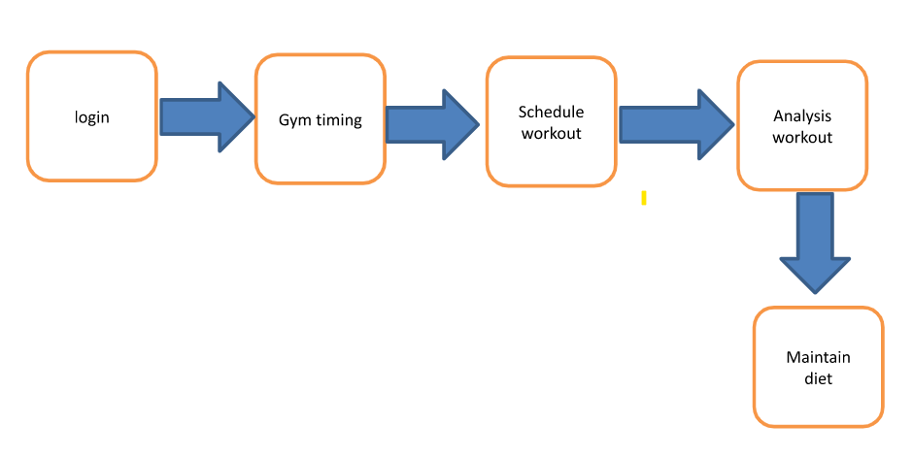
Block diagram

Slide 10
Hardware Requirement
Hardware Requirement
I3 processor system or higher
4 GB RAM or higher
100 GB ROM or higher
Android Phone (6.0 and above)
Software Requirement
Windows 7 or higher
Android Studio

Slide 11
MODULES
USER
A user module in a software system is typically responsible for managing user accounts, authentication, and authorization
WORKOUT SCHEDULING
This module allows users to set specific fitness goals, such as running a 5K race or losing 10 pounds, and track their progress towards those goals. The module may also include tools to create a personalized fitness plan to help users achieve their goals.
FOOD MANAGEMENT
A meal plan or a diet plan, is a tool that helps individuals plan their meals and make healthier food choices.
WEEKLY WORKOUT
This module allows users to track their progress towards their fitness goals, such as weight loss, muscle gain, or endurance. The module may include tools to measure body fat percentage, muscle mass, and other biometric data.
WORKOUT BENEFITS:
This module allows users to track their exercise routines, including the type of exercise, duration, and intensity. The module may also include pre-set workouts or allow users to create their own workouts.

Slide 12
Conclusion
This article discusses the suggested paradigm for India's online voting system. The suggested technique is far more secure and efficient than existing voting methods. Manipulation of votes and postponement of results are easily avoidable. Our suggested concept revolves around a single AADHAAR identification. It facilitates the verification of both voters and candidates. In the proposed framework, we attempted to create a secure online voting system that is free of unauthorised access while voters cast ballots. The proposed system's server elements have such a distribution of authority that the server cannot influence the votes. The proposed online voting method is anticipated to improve the openness and dependability of the current election system.

Slide 13
Reference
[1] Tadayoshi Kohno, Adam Stubblefield, Aviel D.Rubin, Dan S. Wallach,“Analysis of an Electronic Voting System”, Johns Hopkins University Information Security Institute Technical Report, TR-2018-19, July 23,2018 .
[2] http://newindianexpress.com/states/ andhra_pradesh/Maoistsstrike-fear-make-off-with-poll-papers-in-agency/2017/07/ 15/ article1684243. Ece.
[3] Executive Summary of "Genesis and Spread of Maoist Violence and Appropriate State Strategy to Handle it", Bureau of Police Research and Development, Ministry of Home Affairs, New Delhi .
[4] http://en.wikipedia.org/wiki/Electronic_ voting.
[5] David L. Dill, Bruce Schneier, and Barbara Simons, “Voting and technology: Who gets to count your vote?”, Communications of the ACM, vol. 46(8), Aug. 2003, pp. 29–31.
[6] David Jefferson, Aviel D. Rubin, Barbara Simons, and David Wagner, “Analyzing Internet voting security”, Communications of the ACM, vol. 47(10), Oct. 2004, pp. 59–64.
[7] David Evans and Nathanael Paul, “Election security: Perception and reality”, IEEE Security & Privacy, vol. 2(1), Jan. 2016, pp. 24- 31

